Slide 1
TEACHER ONLY — hidden in slideshow
Y7 · Unit 1 · L3 of 4 · 50 minutes
Who got left out? Milestones, and the names that went missing
PRIOR KNOWLEDGE & HANDLING
MISCONCEPTIONS (wrong → right)
LESSON FLOW (50 min)
From Lesson 1: evidence, logic, induction, and that a conclusion is never closed. From Lesson 2: law describes, theory explains.
THIS IS OBJECTIVES 4 AND 5 of the unit, and the SDG 5 lesson. The SoW sets a female/minority scientist poster — the You Do slide starts it.
LESSON 1 ALREADY PLANTED THIS. The Noongar people knew the black swans long before any European wrote them down. Point back to it; they will remember.
HOW TO PITCH IT, and this matters: the lesson is not "science is unfair". It is "evidence only counts if somebody goes and looks, and for most of history a lot of people were never asked". Keep it about the record, not about blame.
ALL THREE PEOPLE ON SLIDE 8 ARE WOMEN. That is deliberate for SDG 5, but say aloud that the same thing happened by class, by country and by race — Mary Anning was poor as well as female, and Katherine Johnson worked in a segregated building.
✗ "Science was invented in Europe."
→ The timeline starts in Basra around 1020. Say the name, put it first, move on.
✗ "There simply were not any women scientists."
→ There were. They were kept out of the societies, the universities and the papers. Being absent from the record is not the same as being absent.
✗ "If your name is not on it, you did not do it."
→ Bell Burnell found the pulsar. Somebody else got the prize.
✗ "That was all a long time ago and it is fixed now."
→ Slide 10 has the numbers. Improving is not the same as fixed.
✗ "Discoveries are made by one clever person."
→ Almost never. Teams, students, assistants and technicians. The name on the paper is a summary, not a headcount.
Title — 1
Today — 1
Do Now — 5
Hook: name three scientists — 5
I Do: the timeline — 5
We Do: which came first? — 4
I Do: three scientists — 8
We Do: who did what? — 4
Context: what changed — 3
You Do: poster plan — 9
Reveal — 2
Plenary: true or false — 3
──────────────
TOTAL 50 min
THE HOOK NEEDS A BOARD. They write three names, you collect them, you count how many are women and how many are from outside Europe and North America. The tally IS the lesson. Do not skip it and do not pre-empt the result.
IF YOU ARE SHORT: cut slide 10. Do not cut slide 8.
NEXT: Lesson 4, into the lab — physical science, equipment and careers.
Notes:
Hidden slide — it will not appear in the slideshow.

Slide 2
Y7 SCIENCE · UNIT 1 · LESSON 3 OF 4
Who got
left out?
Science is a long story. Some of the people in it never got their name written down.
one of these is missing
Notes:
TITLE — 1 minute. The dots lay themselves down, then the caption.
One dot is a different colour. Do not explain it.
SAY: "You have spent two lessons on how science works. Today is about who did it."
TIMING: 30 seconds.

Slide 3



TODAY · 1 MIN
Today’s goals
1
2
3
Put four moments in science in order.
Explain why some names are remembered and some are not.
Name a scientist who was left out, and say what they did.
This is the lesson your poster comes from.
Notes:
TODAY — 1 minute. Four clicks.
Point at the red line. The poster is the unit task and they should know from the start that today feeds it.
RAG grid, START column, now.

Slide 4
DO NOW · 5 MIN
Do Now
Books, name and date. All six. Four minutes.
1
What two things does science run on?
2
What does a scientific law do?
Evidence and logic.
It describes what happens.
3
What does a scientific theory do?
4
"A theory is just a guess." Right or wrong?
It explains why.
Wrong. It is the opposite.
5
Name any scientist.
6
How many women scientists can you name?
Anyone at all.
Keep your number. We need it.
Notes:
DO NOW — 5 minutes: 4 working, 1 marking. Six clicks.
Q1 to Q4 are Lessons 1 and 2. If Q2 and Q3 are shaky, the essay is in trouble — note who.
Q5 AND Q6 ARE THE HOOK LOADING ITSELF. Do not comment on the answers. Just collect the Q6 numbers by show of hands: who wrote zero? one? two or more? Write the tally on the board.
Expect a lot of zeros, and expect the room to notice that themselves. Let the silence sit for a second.

Slide 5
HOOK · 5 MIN
Three famous scientists. Twenty seconds.
1.
2.
3.
Now count. How many are women? How many are from outside Europe and North America?
Why is nearly everybody’s list the same?
A
There were no other scientists.
B
There were. Their names were not written down.
C
Science only happened in Europe.
Vote. We come back to this at the end.
Notes:
HOOK — 5 minutes. Five clicks: the three boxes, the counting line, the question, then the options.
GIVE THEM TWENTY SECONDS, then collect names on the board. Do not curate the list — write down whatever they say.
THEN COUNT, out loud, in front of them. Women. People from outside Europe and North America. The numbers do the teaching and you should not editorialise while you count.
ANSWER (slide 12, not now): B.
C IS WORTH TEN SECONDS. Somebody will pick it, and the timeline on the next slide answers it directly — the first entry is from Basra, five hundred years before Copernicus.
BE CAREFUL NOT TO SHAME THE LIST. Their list is the list they were given. That is precisely the point.

Slide 6





I DO · 5 MIN
milestone
A thousand years, six moments
about 1020
1543
1665
1859
1953
1967
Ibn al-Haytham
Copernicus
Hooke
Darwin
A team in Cambridge
A student in Cambridge
Writes about light — and insists on testing ideas, not just arguing.
Says the Earth goes round the Sun, not the other way round.
Looks through a microscope and sees cells for the first time.
Publishes his explanation of how living things change.
The shape of DNA is worked out. Hold that one.
Spots a signal nobody can explain. Hold that one too.
The story starts in Basra, five hundred years before Copernicus.
Notes:
I DO — 5 minutes. Seven clicks: the six moments, then the banner.
THE FIRST ENTRY IS THE POINT and it answers option C from the hook. Ibn al-Haytham worked in Basra and Cairo around a thousand years ago, and he is the one who insisted that you test an idea rather than argue about it. Lesson 1 in one man.
SAY HIS NAME PROPERLY and get them to say it back. It is the only name on the board today that most of them have never heard.
THE LAST TWO ARE DELIBERATELY VAGUE. "A team in Cambridge." "A student in Cambridge." Say it in exactly those words and do not elaborate. Somebody will ask who. Tell them to hold on.
DO NOT TEACH THE SCIENCE of any of these. One line each. Today is about the story, not about optics or DNA.
STRETCH: "What is missing from this timeline?" Everything outside Europe after 1020, for a start. It is a British school timeline, and saying so out loud is honest.

Slide 7
WE DO · 4 MIN
Which came first?
Whiteboards. Write the earlier one. Hold them up together.
Seeing cells or the shape of DNA?
cells
1665 against 1953. Nearly 300 years apart.
Copernicus or Ibn al-Haytham?
Ibn al-Haytham
About 1020 against 1543. Five centuries earlier.
Darwin or pulsars?
Darwin
1859 against 1967.
The shape of DNA or pulsars?
DNA
1953 against 1967. Only fourteen years apart.
Copernicus or seeing cells?
Copernicus
1543 against 1665.
Notes:
WE DO — 4 minutes. Ten clicks: answer then reason, row by row.
THIS IS AN ORDERING EXERCISE, not a memory test. Leave the timeline up if you can, or let them look back at their books.
ROW 2 is the one worth pausing on. Five hundred years before Copernicus, and almost none of them had heard the name twenty minutes ago.
ROW 4: only fourteen years between DNA and pulsars. Science sped up enormously in the twentieth century, and they can see that in the spacing on the timeline.
IF THE ROOM IS SECURE by row 3, do the last two orally.

Slide 8
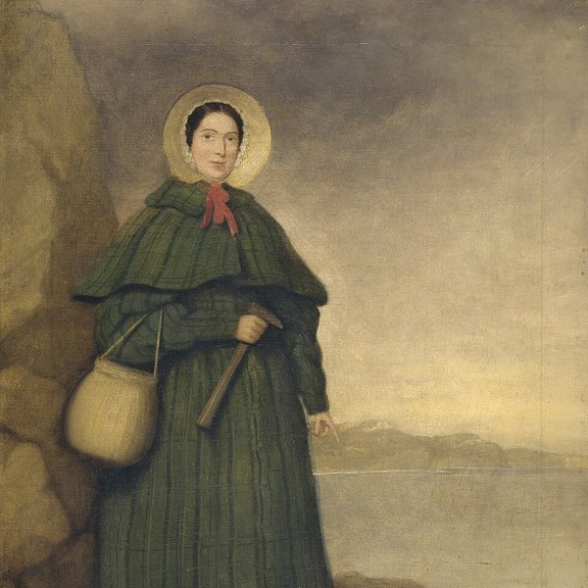
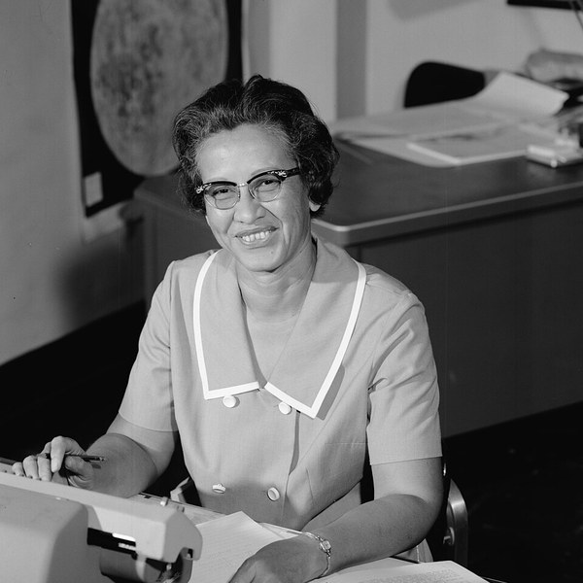
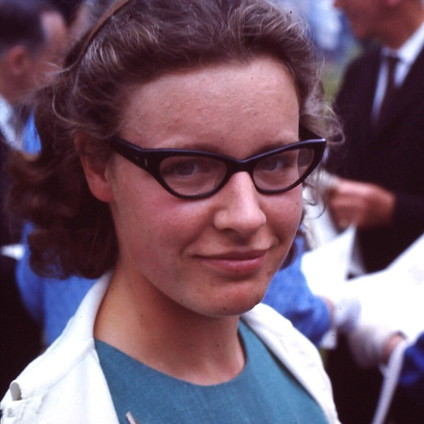
I DO · 8 MIN
Three scientists you were not told about
Mary Anning
Katherine Johnson
Jocelyn Bell Burnell
1799–1847
1918–2020
born 1943
Aged twelve, she dug out the first complete fossil of an ichthyosaur.
She worked out the flight path for the first American to orbit the Earth.
As a student in 1967 she spotted the first pulsar in a pile of paper charts.
Papers about her fossils often left her name out. Women could not join the Geological Society of London until 1904 — fifty-seven years after she died.
He would not fly until she had checked the computer by hand. "If she says they’re good, then I’m ready to go."
The Nobel Prize went to her supervisor. In 2018 she won $3 million and gave every penny away to help under-represented students study physics.
Notes:
I DO — 8 minutes, the heart of the lesson. Nine clicks: for each person, the photo and name, then what they did, then what happened.
REVEAL WHAT THEY DID BEFORE WHAT HAPPENED TO THEM, every time. They should be impressed first and indignant second. That order matters.
ANNING: she was twelve. Say the age and wait — it is the same age as most of the room. She was also poor, and that mattered as much as being female.
JOHNSON: read the quotation aloud. She worked in a segregated building; the astronaut still would not fly until she said the numbers were right.
BELL BURNELL: connect her to the timeline. That 1967 entry, "a student in Cambridge", was her. She has said publicly that the Nobel did not bother her much, and then she gave away three million dollars to help people like her. Do not turn her into a victim — she would object.
ALL THREE ARE WOMEN and that is deliberate, but say aloud that the same thing happened by class, by country and by race. Anning was poor. Johnson was Black in a segregated America.
THE PHOTO OF BELL BURNELL is from 1967, the year she found it. She is the age of a sixth-former in it. Point that out.

Slide 9
WE DO · 4 MIN
Who did what?
Whiteboards. Write A for Anning, J for Johnson, B for Bell Burnell.
Found the first complete ichthyosaur, aged twelve.
A
Checked a computer by hand before a spaceflight.
J
Spotted the first pulsar while still a student.
B
Was not allowed to join the Geological Society.
A
Gave away a three million dollar prize.
B
Worked out the path for the first American to orbit Earth.
J
Notes:
WE DO — 4 minutes. Six clicks, one letter each. Boards up BEFORE you click.
Leave slide 8 up if you have a second screen, or let them use their books. This is a recall check, not a memory test.
ROWS 1 AND 4 ARE BOTH ANNING and that pairing is the point: the same person did something remarkable and was shut out of the room where it was discussed.
AFTER ROW 6, ask the open question: "which of these three do you want to find out more about?" That is the poster choice, and taking it now saves five minutes later.

Slide 10
CONTEXT · 3 MIN
What changed, and what has not
1904
1974
2018
now
Women were finally allowed to join the Geological Society of London.
The Nobel Prize for pulsars went to the supervisor, not the student who found them.
Bell Burnell gave away a three million dollar prize to fund students from groups that are still missing.
By 2023, five women had won the Nobel Prize in Physics. The first was in 1903.
Better is not the same as finished. That is a sentence about science as well as about scientists.
Nobel figure correct to 2023: Curie 1903, Goeppert Mayer 1963, Strickland 2018, Ghez 2020, L’Huillier 2023.
Notes:
CONTEXT — 3 minutes. Five clicks.
CHECK THE NOBEL NUMBER BEFORE YOU TEACH IT. Five is correct to 2023 and the five names are in the footer. If it has changed since, changing the slide takes ten seconds and modelling that you checked is worth more than the number itself.
THE CLOSING LINE DOES DOUBLE DUTY. Better is not finished — true of who gets recognised, and true of every scientific conclusion they met in Lesson 1. Say both halves.
DO NOT LET THIS BECOME GLOOMY. The 1904 card and the 2018 card are both good news. The direction of travel is clear; the arrival is not.
CUT THIS SLIDE FIRST if you are behind.

Slide 11
YOU DO · 9 MIN
Start your poster
Worksheet sections A to C, then plan your poster on the back.
BRONZE
SILVER
GOLD
Fluency
Mixed practice
Reasoning
Order the timeline. Match the scientist to what they did.
Explain why a name can go missing from the record.
Plan your poster. Choose your scientist and say why.
Researching your poster? Use Gemini properly.
Three prompts on the last page of your worksheet. One helps you find a scientist, one checks whether a fact is actually true, one marks your plan. None of them writes the poster for you. Anything it tells you, find a second source that says the same thing.
RAG grid, front page — fill in the "end of lesson" column before you pack away.
Notes:
YOU DO — 9 minutes. Four clicks.
THE POSTER IS THE UNIT TASK. Nine minutes will not finish it, and it is not meant to. They choose a person and plan; the making happens for homework or in Lesson 4's spare time.
THE WORKSHEET LISTS SIX MORE SCIENTISTS to choose from beyond today's three, so nobody is stuck picking from a list of three.
CIRCULATE WITH ONE QUESTION: "how do you know that is true?" The second-source rule is the Lesson 1 idea doing real work.
AT 2 MINUTES REMAINING, stop them.

Slide 12
REVEAL · 2 MIN
So — why is everybody’s list the same?
The answer was B.
They were there. Somebody just did not write them down.
They were kept out.
They were not asked.
The credit went elsewhere.
Out of the societies, the universities, and the papers.
Evidence only counts if somebody goes and looks. Often nobody did.
The name on the paper is not always the person who found it.
Your list was the list you were given. Now you can add to it.
Notes:
REVEAL — 2 minutes. Six clicks: the dots, the line, the three points, then the banner.
Go back to the board where their three names are still written. Announce B.
THE DARK DOT is the same device as the title slide and as the black swan in Lesson 1. Nobody will mention it.
THE BANNER IS THE ONE TO SAY SLOWLY. Their list was not their fault. It was the list they were handed. The point of the lesson is that they can now hand on a longer one.
DO NOT END ON GUILT. End on the poster.

Slide 13
PLENARY · 3 MIN
True or false?
Stand up for TRUE. Stay sitting for FALSE.
1. Science has only ever been done in Europe.
FALSE
The timeline starts in Basra.
2. Mary Anning was kept out of the Geological Society for being a woman.
TRUE
Women could not join until 1904.
3. Jocelyn Bell Burnell won the Nobel Prize for finding pulsars.
FALSE
She found them. Her supervisor got the prize.
4. A discovery can be made by someone whose name is not on it.
TRUE
That is most of today’s lesson.
5. All the important science has already been found.
FALSE
Lesson 1: a conclusion is never closed.
Next lesson: into the lab — and what this subject can actually get you.
Notes:
PLENARY — 3 minutes. Eleven clicks.
Q3 IS THE ONE TO WATCH. If they stand up, they have heard "Bell Burnell" and "Nobel" in the same lesson and merged them. Worth correcting firmly — the whole point is that she did not get it.
Q5 pulls Lesson 1 back in. A conclusion is never closed, and neither is the list of who did the work.
THE MOTIF RETURNS top right.
REMIND THEM about the poster before they leave.

Slide 14
Credits and sources
IMAGES
Mary Anning, painted about 1842
Credited to "Mr Grey" · public domain · Wikimedia Commons
Katherine Johnson at NASA Langley, 1966
NASA · public domain
Jocelyn Bell Burnell, 1967
Roger W Haworth · CC BY-SA 2.0 · Wikimedia Commons
SOURCES
Anning: first complete ichthyosaur, 1811; she was twelve
Natural History Museum; Lyme Regis Museum
Women admitted to the Geological Society of London in 1904
Lyme Regis Museum
Johnson: Glenn asked for her to check the numbers by hand, 1962
NASA, Katherine Johnson Biography
Bell Burnell: pulsar 28 November 1967; Nobel 1974 to Hewish and Ryle
University of Cambridge; Britannica
Bell Burnell: $3m Breakthrough Prize 2018, donated in full
Institute of Physics studentships for under-represented groups
Notes:
Not shown in the lesson unless someone asks.

